Slide 1
Cultural safety education and training framework
Launch 8 Feb 2023

Slide 2
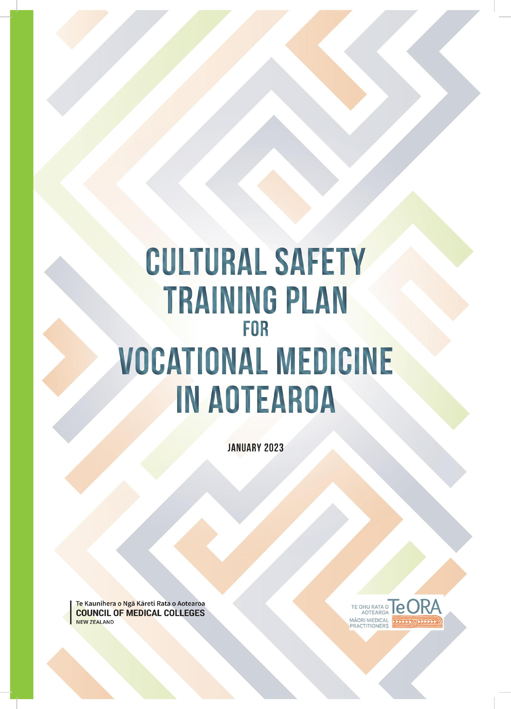
Launched 8 Feb 2023
Te Raukura, Wharewaka

Slide 3
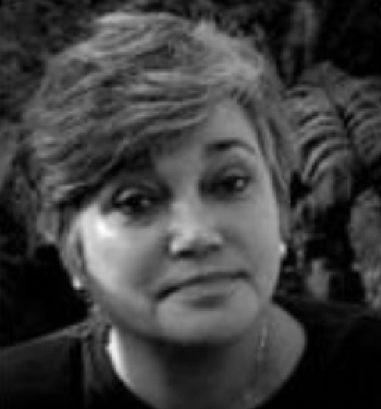
Te Kawa Whakaruruhau
Nursing did it first
Getting the best outcomes for Māori
Dr Irihapeti Ramsden
Notes:
Nurses did it first.
Getting the best outcomes for Māori
Indigeneity, colonisation and the Treaty of Waitangi
Māori nurses – cultural safety in training and in service
Educating nurses – non-judgemental and to NOT
“blame the victims of historical and social processes”
Controversial:
Powerful and negative media protrayals,
Complaints by students and tutors,
Select Committee investigation.
Scapegoat for right wing conservatism

Slide 4
Te Kawa Whakaruruhau
Nursing education approach
‘Our own’ stuff not about ‘others’
Critical consciousness and reflective practice
Power relationships
Patient rights
Dr Irihapeti Ramsden
Notes:
Critical consciousness/reflective practice
around health outcomes (and colonisation)
Transforms professional power relationships
Champions patient rights to determine cultural safety
Ethnic gender age ability sexuality religion

Slide 5
The Medical Journey
1980s
You could be sensitive to Māori need
2000s
You should
up your game with Māori patients
2020s
You must
know how your attitudes and biases affect outcomes

Slide 6
The Medical Journey
Knowledge base
Skills and behaviours
Self-reflective practice
Hauora Māori
Notes:
Acknowledge the role of medical schools in developing content and structure around teaching
And now including all three component

Slide 7
Cultural Competence Legislation
The Health Practitioners Competence Assurance Act 2003
Section 118(i) … standards of clinical competence, cultural competence and ethical conduct …
Health Practitioners Competence Assurance Amendment Act 2019
… standards of clinical competence, cultural competence (including competencies that will enable effective and respectful interaction with Māori), and ethical conduct …

Slide 8
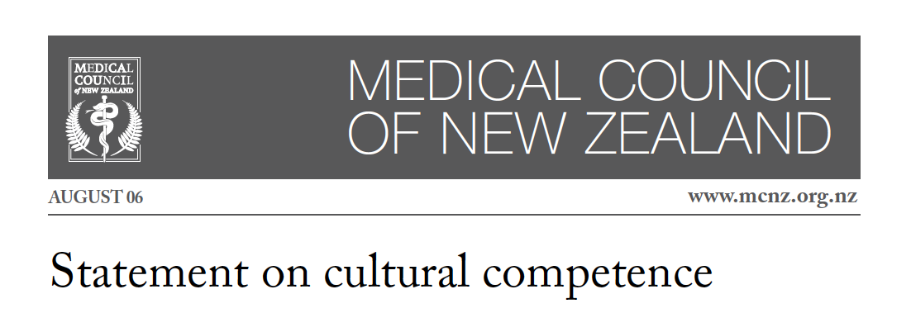
Cultural Competence Standards (2016)
Notes:
Bound to do this by the HPCA Act:
Trusting relationships, promoting communications, increasing compliance AND ensuring better outcomes and increasing satisfaction
Defined CC. …. an awareness of cultural diversity and the ability to function effectively, and respectfully,
…. has the attitudes, skills and knowledge needed to achieve this

Slide 9
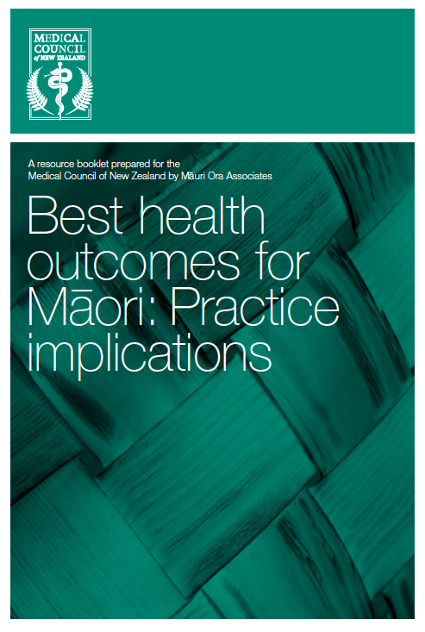
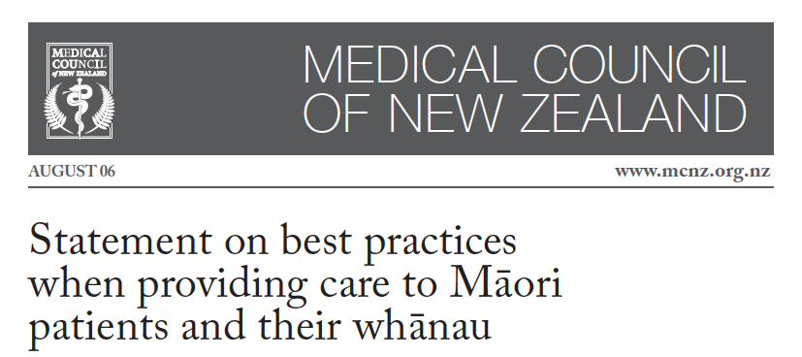
Cultural Competence Standards (2006)
Notes:
How to do it pieces.
The statement(s) were due for RV in 2011.

Slide 10
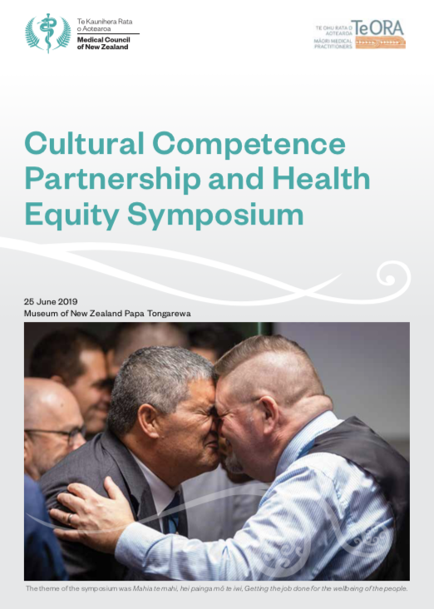
Cultural Competence Standards (2016)
Partnership with Te ORA
Two major national symposiums
Notes:
One of MCNZ 5 strategic directions
Partnership project with Te ORA 2016
2 major symposiums

Slide 11
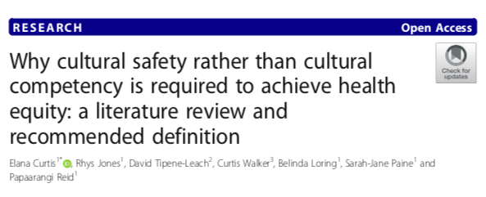
Cultural Safety (2019)
International Journal for Equity in Health (2019)18:174
Notes:
RVs the terms CC and CS
Relationship to health equity
Cult Comp to Cult Safety
Steps to operationalise Cultural Safety
DEFINITION Critique the power structures and challenge own culture >>> becoming ‘competent’ in the cultures of others
Practitioner behaviour clearly linked to achieving health equity
Organisations/authorities held accountable for providing culturally safe care
CS defined by patients and their communities,
AND measured through progress towards achieving health equity

Slide 12
Cultural Safety (2019)
Notes:
THE MCNZ’s THEORETICAL BASIS AND OBJECTIVES FOR CULTURAL SAFETY
“competence-based approach alone will not deliver improvements in health equity”
Power relationships need to change AND patients must have the power to comment on practices, be involved in decision-making
Indigenous status, age or generation, gender, sexual orientation, socioeconomic status, ethnicity, religious or spiritual belief and disability
DEFINED AS a critical consciousness where healthcare professionals and healthcare organisations engage in ongoing self-reflection and self-awareness
and hold themselves accountable for providing culturally safe care, as defined by the patient and their communities
Understanding how our colonial history, systemic bias and inequities have impacted Māori
Health Equity - Indigenous rights of Māori within New Zealand and supports the principles of the Treaty of Waitangi.

Slide 13
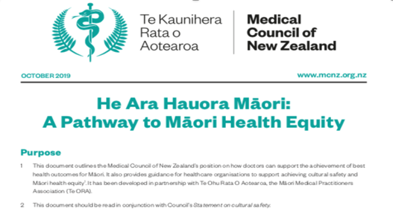
Cultural Safety (2019)
A ‘how to’ pathway for using cultural safety to effect Māori health equity
Notes:
THE MCNZ’s THEORETICAL BASIS AND OBJECTIVES FOR CULTURAL SAFETY
“competence-based approach alone will not deliver improvements in health equity”
Power relationships need to change AND patients must have the power to comment on practices, be involved in decision-making
Indigenous status, age or generation, gender, sexual orientation, socioeconomic status, ethnicity, religious or spiritual belief and disability
DEFINED AS a critical consciousness where healthcare professionals and healthcare organisations engage in ongoing self-reflection and self-awareness
and hold themselves accountable for providing culturally safe care, as defined by the patient and their communities
Understanding how our colonial history, systemic bias and inequities have impacted Māori
Health Equity - Indigenous rights of Māori within New Zealand and supports the principles of the Treaty of Waitangi.

Slide 14
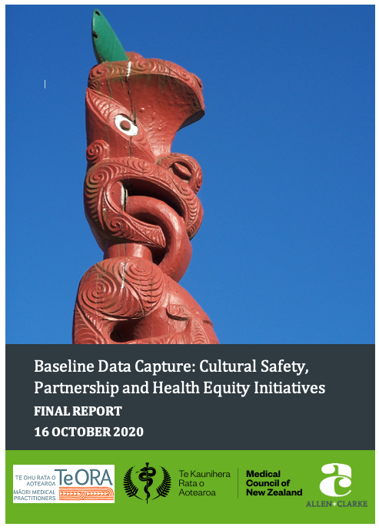
Cultural Safety (2020)
Robust data
Racism and Pākehā privilege
Partnerships with Māori
Workforce recruitment
Self-reflection - culturally-safe practice
Cultural loading on Māori doctors
Notes:
Robust ethnicity data for equity monitoring
Systemic racism - structural barriers - Pākehā privilege
Partnerships with Māori
Workforce recruitment strategies
Focussing on self-reflection and culturally-safe practice
Cultural loading on Māori doctors

Slide 15
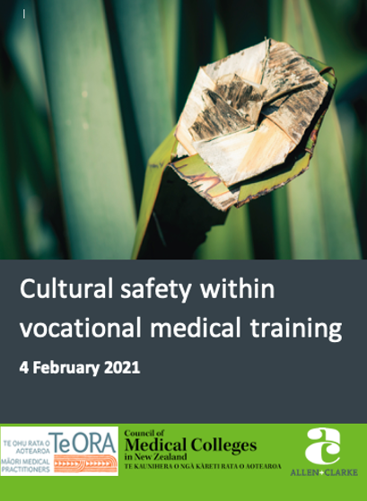
Cultural Safety (2021)
Māori in College governance?
Māori employees?
Budget for Māori projects?
Training programmes?
Cultural safety policy?
Numbers of Māori trainees?
Experience of cultural safety?
Cultural loading
Notes:
Survey (2017 & 2020) and IVs Māori Drs
Some Some Few Poor No Few Few

Slide 16
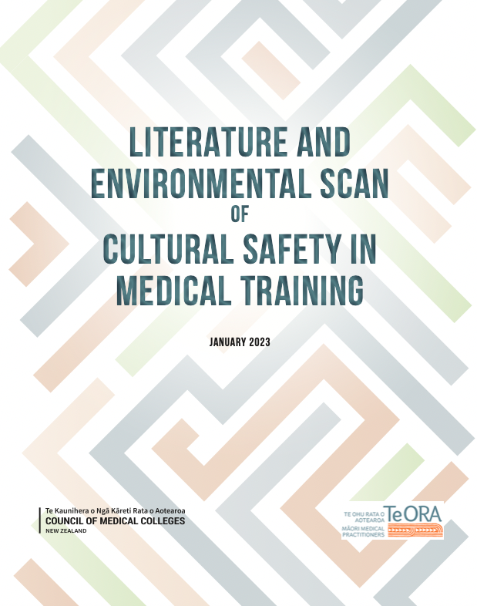
Cultural Safety (2023)
Mostly cultural competence
Hauora Maori and Cultural Competence integrated
Mixture of teaching methods
No standard assessment
Cultural Competence, Cultural Safety and equity not understood
Position statement crucial
Notes:
Survey (2017 & 2020) and IVs Māori Drs
Some Some Few Poor No Few Few

Slide 17
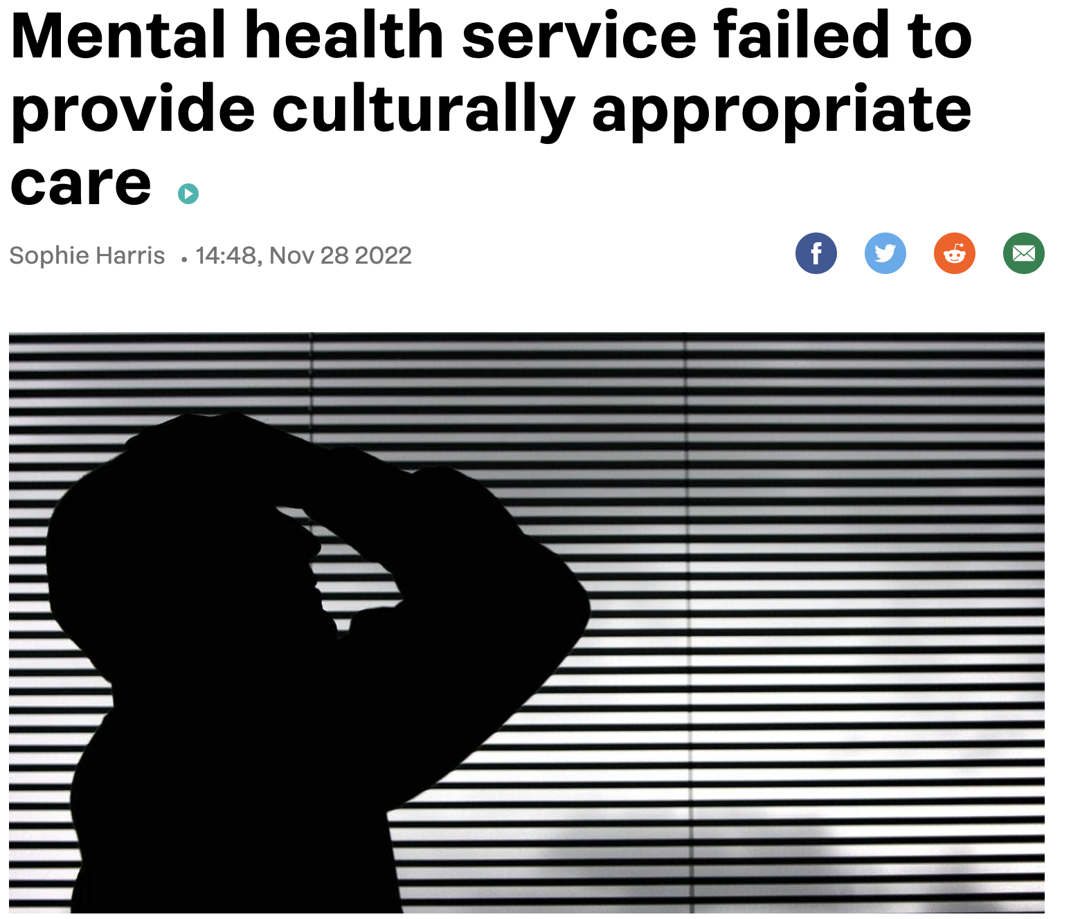
Hot off the Press (Nov, 2022)
Notes:
Te Whatu Ora – in breach of the Code of Health&Dis
Services Consumers’ Rights
Death in mental health care
Health and Disability Commission
“Multiple failures” by staff
3/12 her cultural needs were not assessed,
and she was not provided with culturally safe care
history, assessment, whānau inclusion,
Under Right 1(3) of the Code: right …
for their needs, values, and beliefs of different
cultural, religious, social, and ethnic groups.

Slide 18
Hot off the Press (Nov, 2022)
Effective and respectful
interaction with Māori:
How the regulators of health
professionals are responding
to the HPCA Amendment Act 2019
Susan Shaw, Keith Tudor NZMJ 136(1569)
Medical-Physio-OT-Midwifery-Paramedics-Nursing-RadTech-Dental-Osteopathy-Pharmacy-Optomerty-Chiropractic-Dietitan-MedSciences-Psychology-Podiatry-Psychotherapy
Notes:
Document scan of
the response 17 RAs to HPCA Amendment
That practitioners are culturally competent and enable
“effective and respectful interaction with Māori”
Shows limited progress
8/17 publish a CC related competency
4/17 fully reference the HPCAA 2019
2/17 extension of cultural competence-related Fx

Slide 19
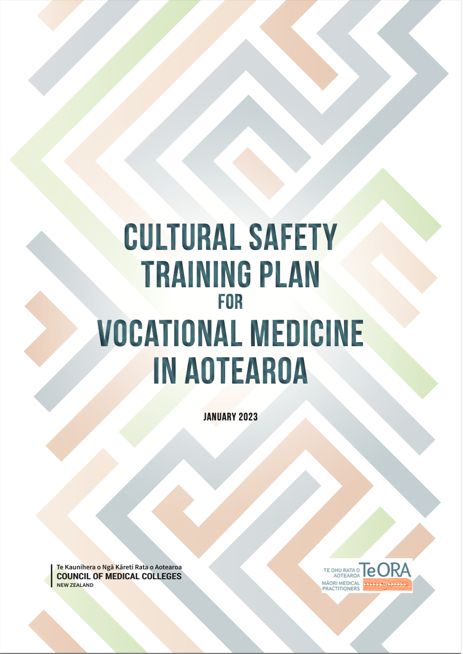
Cultural Safety Training Plan (2023)
To provide the foundation
for vocational medical college education
and training programmes
that support practitioners
to undertake culturally safe practice
in their medical specialty.
Notes:
Survey (2017 & 2020) and IVs Māori Drs
Some Some Few Poor No Few Few

Slide 20
Developing the training plan 1. Review of literature 2. Interviews with medical colleges 3. consumer reference group consultation 4. Testing and refining Team: David Tipene-Leach, Shirley Simmonds, Marnie Carter (Allen+Clarke), Helena Haggie, Mataroria Lyndon, Virginia Mills
Notes:
MARNIE
This framework has been developed based on the findings of a literature and environmental scan that identified the characteristics of education and training initiatives and assessment methods that evidence shows best meet the cultural safety training needs of doctors. The literature scan incorporated information from 44 journal articles or reports (see reference list), and 24 publicly available materials related to cultural safety and cultural competence training for doctors, including medical college curricula, continued professional development (CPD) programmes, and course outlines from training providers.
The literature scan was supplemented by an environmental scan which consisted of interviews with representatives (such as academic advisors or training officers) from a sample of six medical colleges. The sample of six colleges included: Australasian and Aotearoa-specific colleges; colleges of different sizes, including one considered ‘very small’; colleges with low Māori representation amongst trainee practitioners and fellows, and one with higher Māori representation; and colleges in specialisations that have close contact with patients, and those that do not.

Slide 21
Conceptual framework for optimal health
for Māori in Aotearoa
Notes:
SHIRLEY
This overarching framework illustrates the full set of proficiencies that doctors need to practice in a culturally safe way.
It emphasises that cultural competence and hauora Māori remain critical to medical college vocational education and training and CPD programmes. It is important that vocational training retains a focus on these areas, as they are a vital part of being a culturally safe practitioner.
[Go through framework and discuss]

Slide 22
Definitions
Hauora Māori
All medical practitioners have a knowledge base that includes: The historical and contemporary Māori health situation Māori health models Māori engagement practices Adequate te reo Māori The diversity of Māori beliefs, values and experiences.
Cultural competence
Culturally competent medical practitioners have a skills base that includes: Working effectively within cross-cultural contexts Using a definition of culture that is wider than ethnicity ie other social groups defined by their behaviours, beliefs and values.
Cultural safety
Culturally safe medical practitioners have a critical consciousness that includes: Self-reflection on their own biases, attitudes, assumptions, stereotypes and prejudices Self-reflection on wider structures and characteristics that may affect their practice.

Slide 23
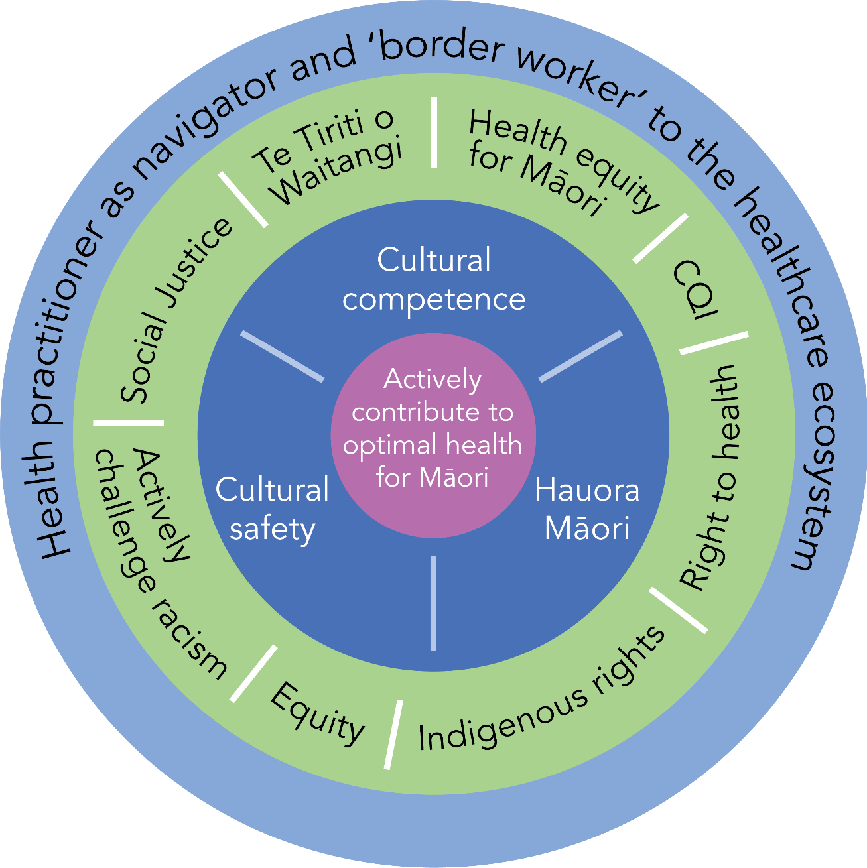
Proficiencies
Culturally safe practice:
Engage in ongoing development of critical consciousness
Examine and redress power relationships
Commit to transformative action
Ensure that ‘cultural safety’ is determined by patients and communities served

Slide 24
Enabling Proficiencies, Teaching Methods, and Assessment

Slide 25
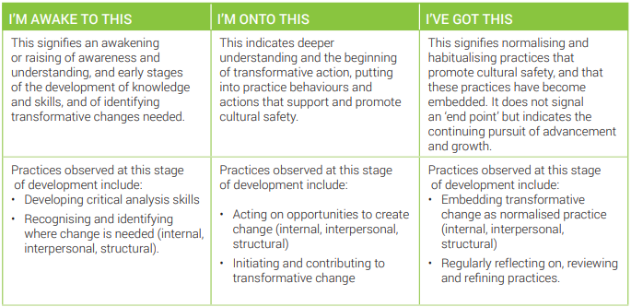
Cultural Safety Self-assessment Tool

Slide 26
Implementation points to consider:
This is an Aotearoa context
Cultural safety of college organisations and their environments
Curriculum development – contextualising to each college
Delivery of training – educator workforce
Avoiding cultural overload

Slide 27
Issues - training
What training activities are currently taking place
In your college?
In your work place?
In your personal practice?
Do they include cultural safety?

Slide 28
Issues - training
Māori health and cultural competence not implemented in some colleges.
Is Hauora Māori/cultural competence a generic programme with tweaks for different colleges?
Is cultural safety a separate programme?
Who develops cultural safety training? External advice?
Assessment and monitoring: “Fun, easy and necessary”
The nature of compliance monitoring

Slide 29
Unresolved contextual issues
Cultural safety gap between training and service
Culturally safe behaviour: personal and organizational
Cultural safety excuses: workforce fatigue and resource restriction
Culturally safe environments for young Māori doctors
Cultural safety and equity issues not well understood

Slide 30
Karawhiua! KIA KAHA

